Slide 1
Advanced Sorting

Slide 2
Bucket Sort
It works by partitioning data into a number of buckets. Each bucket is then sorted individually, either using a different sorting, or recursively applying bucket sorting.
Average complexity is O(n+k) and worst case is O(n²) where k is the number of bits used to represent numbers and n is the number of buckets.

Slide 3
Bucket Sort Approach
Set up an array of initially empty buckets.
Scatter: Go over the original array, putting each object in its bucket.
Sort each non-empty bucket.
Gather: Visit the buckets in order and put all elements back into the original array.

Slide 4
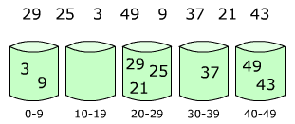
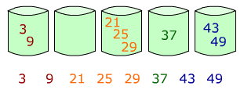
Bucket sort: example

Slide 5
Bucket sort: example
.78
.17
.39
.26
.72
.94
. 21
.12
.23
.68
0
.12
0
1
.17
.12
1
.12
.17
.17
2
.26
.21
.23
2
.21
.23
.26
.21
3
.39
3
.23
.39
4
4
.26
5
5
.39
6
.68
6
.68
.68
7
.78
.72
7
.72
.72
.78
8
8
.78
9
.94
9
.94
.94

Slide 6
Radix Sort
It uses positional value of the data to sort.
Digits or characters are compared having same significant position.
Ques. Perform Radix Sort on : 170, 45, 75, 90, 802, 24, 2, 66

Slide 7
Radix Sort : Example
329, 457, 657, 839, 436, 720, 355

Slide 8
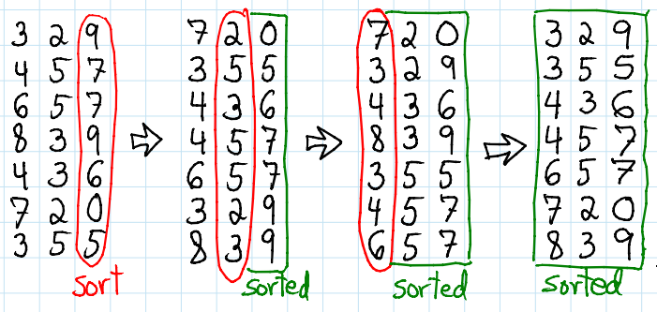
Radix Sort : Example
329, 457, 657, 839, 436, 720, 355

Slide 9
Algorithm: Radix-Sort (list, n)
shift = 1
for loop = 1 to keysize do
for entry = 1 to n do
bucketnumber = (list[entry].key / shift) mod 10
append (bucket[bucketnumber], list[entry])
list = combinebuckets()
shift = shift * 10

Slide 10
Quick Sort
We choose the first element as the pivot. Set loc = 0, left = 0, right = 5 as,
27 | 10 | 36 | 18 | 25 | 45
0
1
2
3
4
5
Scan from right to left. Since a[loc] < a[right], decrease the value of right.
27 | 10 | 36 | 18 | 25 | 45
Left
Right
Since, a[loc] > a[right], interchange the two values and set loc = right = 4.
25 | 10 | 36 | 18 | 27 | 45
Left
Right

Slide 11
Start scanning from left to right. Since, a[loc] > a[right], increment the value of left.
25 | 10 | 36 | 18 | 27 | 45
Left
Left
Right
Now since, a[loc] < a[right], interchange the values and set loc = left = 2
25 | 10 | 27 | 18 | 36 | 45
Since, a[loc] > a[right], interchange the two values and set loc = right=3.
Left
Right
25 | 10 | 18 | 27 | 36 | 45
Left
Right

Slide 12
Quick Sort - Algorithm
PARTITION ( ARR, BEG, END, LOC)
Step 1: [Initialize] SET LEFT = BEG, RIGHT = END, LOC = BEG, FLAG = 0
Step 2: Repeat Steps 3 to while FLAG = 0
Step 3: Repeat while ARR[LOC] <= ARR[RIGHT] AND LOC != RIGHT
SET RIGHT = RIGHT – 1
[END OF LOOP]
Step 4: IF LOC == RIGHT, then
SET FLAG = 1
ELSE IF ARR[LOC] > ARR[RIGHT], then
SWAP ARR[LOC] with ARR[RIGHT]
SET LOC = RIGHT
[END OF IF]

Slide 13
Quick Sort - Algorithm
Step 5: IF FLAG = 0, then
Repeat while ARR[LOC] >= ARR[LEFT] AND LOC != LEFT
SET LEFT = LEFT + 1
[END OF LOOP]
Step 6: IF LOC == LEFT, then
SET FLAG = 1
ELSE IF ARR[LOC] < ARR[LEFT], then
SWAP ARR[LOC] with ARR[LEFT]
SET LOC = LEFT
[END OF IF]
[END OF IF]
Step 7: [END OF LOOP]
Step 8: END

Slide 14
Quick Sort - Algorithm
QUICK_SORT ( ARR, BEG, END)
Step 1: IF (BEG < END), then
CALL PARTITION ( ARR, BEG, END, LOC)
CALL QUICKSORT(ARR, BEG, LOC – 1)
CALL QUICKSORT(ARR, LOC + 1, END)
[END OF IF]
Step 2: END

Slide 15
Merge Sort
Merge sort takes advantage of the ease of merging already sorted lists into a new sorted list.
It is a divide and conquer algorithm. It can be easily parallelized. It takes advantage of the fact if numbers are already sorted.
It works better because it deals with smaller lists instead of the full list.
Its best, worst and average case running time is O(n log n). It is better than previously discussed algorithms.

Slide 16
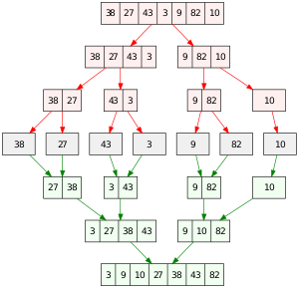

Slide 17
Algorithm
MERGE-SORT(A)
Step 1: If length[A] = = 1 then
Return A
Else
q=int(Length[A]/2)
Create arrays L[1..q] and R[q+1..length[A]]
copy A[1..q] to L
copy A[q+1.. length[A]] to R
LS=MERGE-SORT(L)
RS=MERGE-SORT(R)
Return Merge(LS, RS)
EndIf
Step 2: Exit

Slide 18
Merge(L,R)
Step 1: Create array B of length[L] + length[R]
Step 2: Set i=1, j=1
Step 3: For k= 1 to length[B] do
If j> length[R] or ( i<=length[L] and L[i]<=R[j] ) then
B[k]=L[i]
i=i+1
Else
B[k]=R[j]
j=j+1
Step 4: Return B
At the end of each iteration of for loop in step 3 the sub array B[1..k] contains smallest k elements k elements from L and R in sorted order

